Slide 1
Allied Geophysical Lab
Research Presentations
April 2, 2014
Near-Surface Events…
Friend of Foe ?
Fred Hilterman
Distinguished Research Professor
EAS, University of Houston
Chief Scientist
Geokinetics Data Processing & Integrated Reservoir Geosciences
Notes:
1. I’d like to travel a slightly different path for the next few minutes and reminisce about recognizing noise from signal … for the last 30 years.
2. This recognition was assisted by seismic modeling that is often called reflectivity seismograms.
3. These recognitions are various “Eureka! Eureka!” moments. I’m sure you have also experienced similar “I found it” moments during your geoscience career.

Slide 2
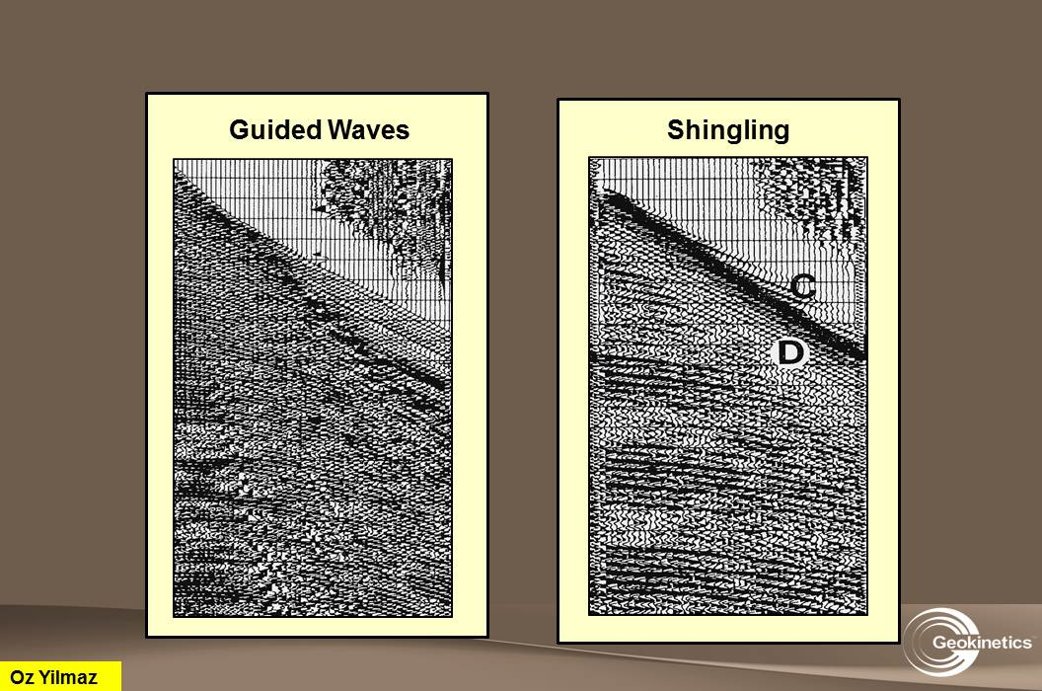
Field Record
Typical Interpretation Problem
What are shingles?
Are they lateral gaps in the refractor?
Objective: Provide quantitative insight into how near-surface events are generated.
We’ll go the easy way … generate a catalog of synthetics.
Oz Yilmaz
Notes:
There are two distinctive first arrival patterns shown … shingles and guided waves.
Can these first arrivals be used for refraction?
What would help is if we knew what causes the shingling and guided wave patterns?
Rather than try any theoretical derivation, we’ll cop out and make a catalog of synthetics and see if they correspond.

Slide 3
Outline
Near-Surface Events …
Elastic synthetics
  Identify events
  Define asymptotes of events
  Vary near-surface thickness
  Vary refractor thickness
Notes:
1. Here are examples from the last 30 years where the reflectivity code allowed us to shout “Eureka” … look “I found it”.
2. The first part of my talk covers near-surface events and leads to an understanding of the various “noise” cones we see on shot records.
3. Secondly, a new processing algorithm was developed, that is imaging shallow portions of salt domes by 3D migration of refraction arrivals. This was undertaken once the failure of the reflection process was recognized by reflectivity modeling.
4. The last example relates to the identification of signal from noise in Cooper Basin coal beds and leads to a method of separating S and N.

Slide 4
Modeling Philosophy
Half
Space
5600, 0, 2.00
850 ft
Start with
Simplest model !
ft/s ft/s g/cc
Refractor
Half
Space
9000, 0, 2.24
Notes:
Once again, let’s look at the problem with various degrees of complication. This is one of the simplest models for a reflection because the shear wave velocity is set to zero, that is, an acoustic model. Also, there is only one boundary between the two half spaces. Everybody seems relieved that their guess of a single PP reflection was correct. The next step is to introduce shear-wave velocities.

Slide 5
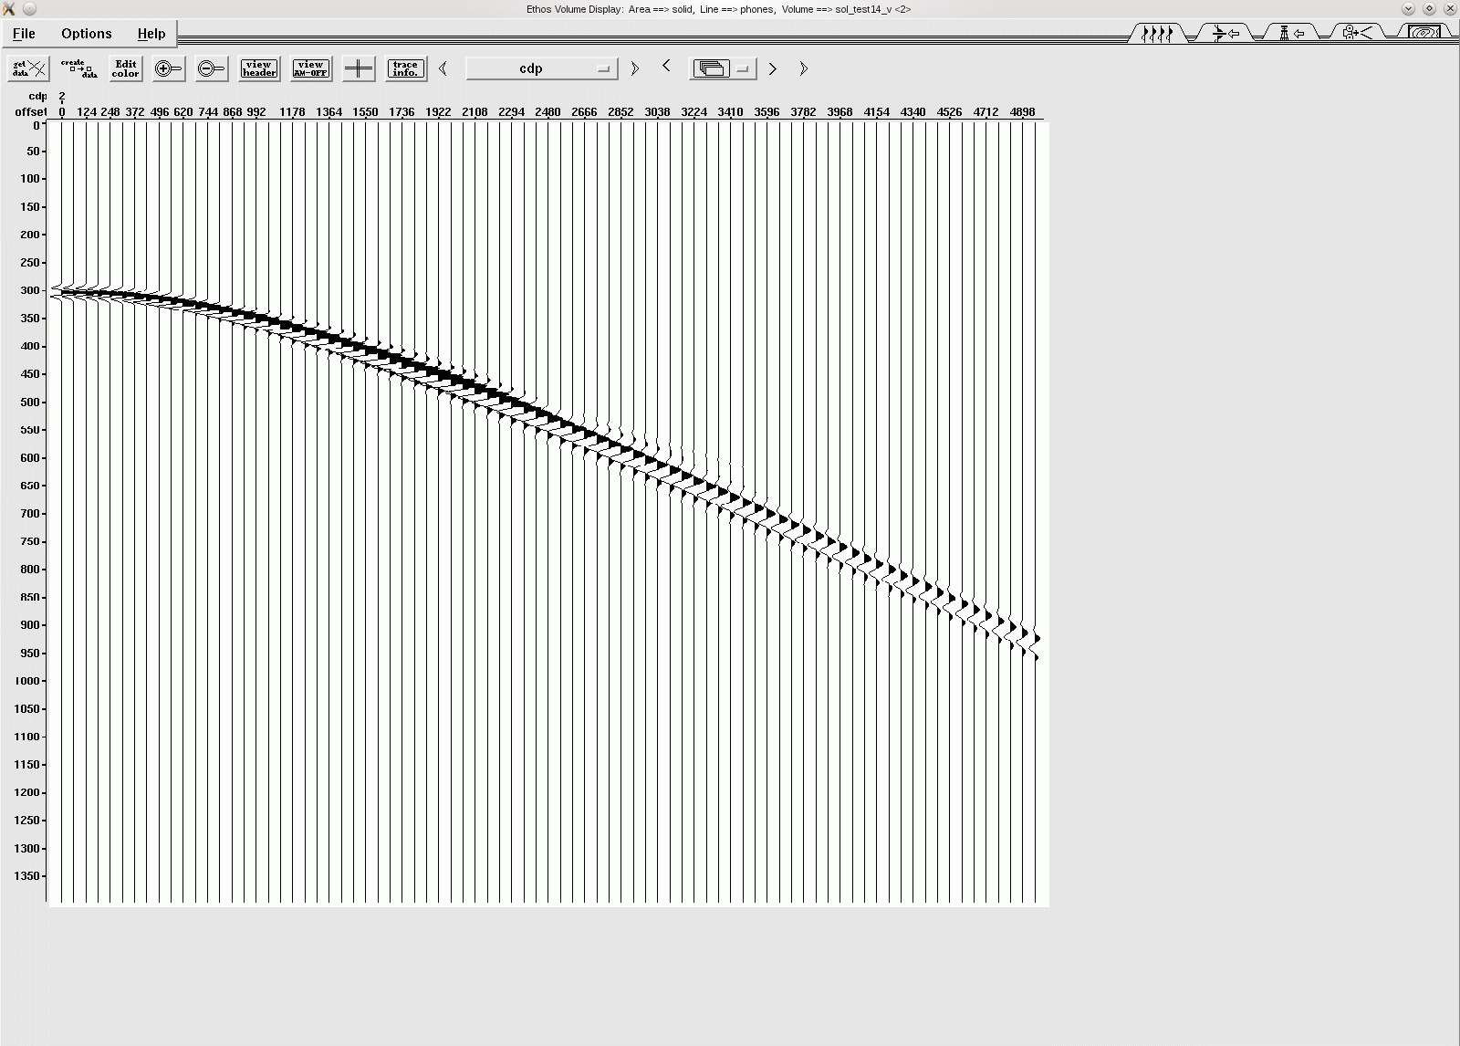
Simplest Acoustic Model
Half
Space
5600, 0, 2.00
850 ft
Acoustic
V_{SHEAR} = 0
ft/s ft/s g/cc
Refractor
Half
Space
9000, 0, 2.24
0 ft
Source-Receiver Offset
5000 ft
|
|
|
|
|
|
_
0s
_
_
(P₁P₁)
_
_
_
.5s
_
_
_
_
_
1.0s
_
_
_
Notes:
Once again, let’s look at the problem with various degrees of complication. This is one of the simplest models for a reflection because the shear wave velocity is set to zero, that is, an acoustic model. Also, there is only one boundary between the two half spaces. Everybody seems relieved that their guess of a single PP reflection was correct. The next step is to introduce shear-wave velocities.

Slide 6
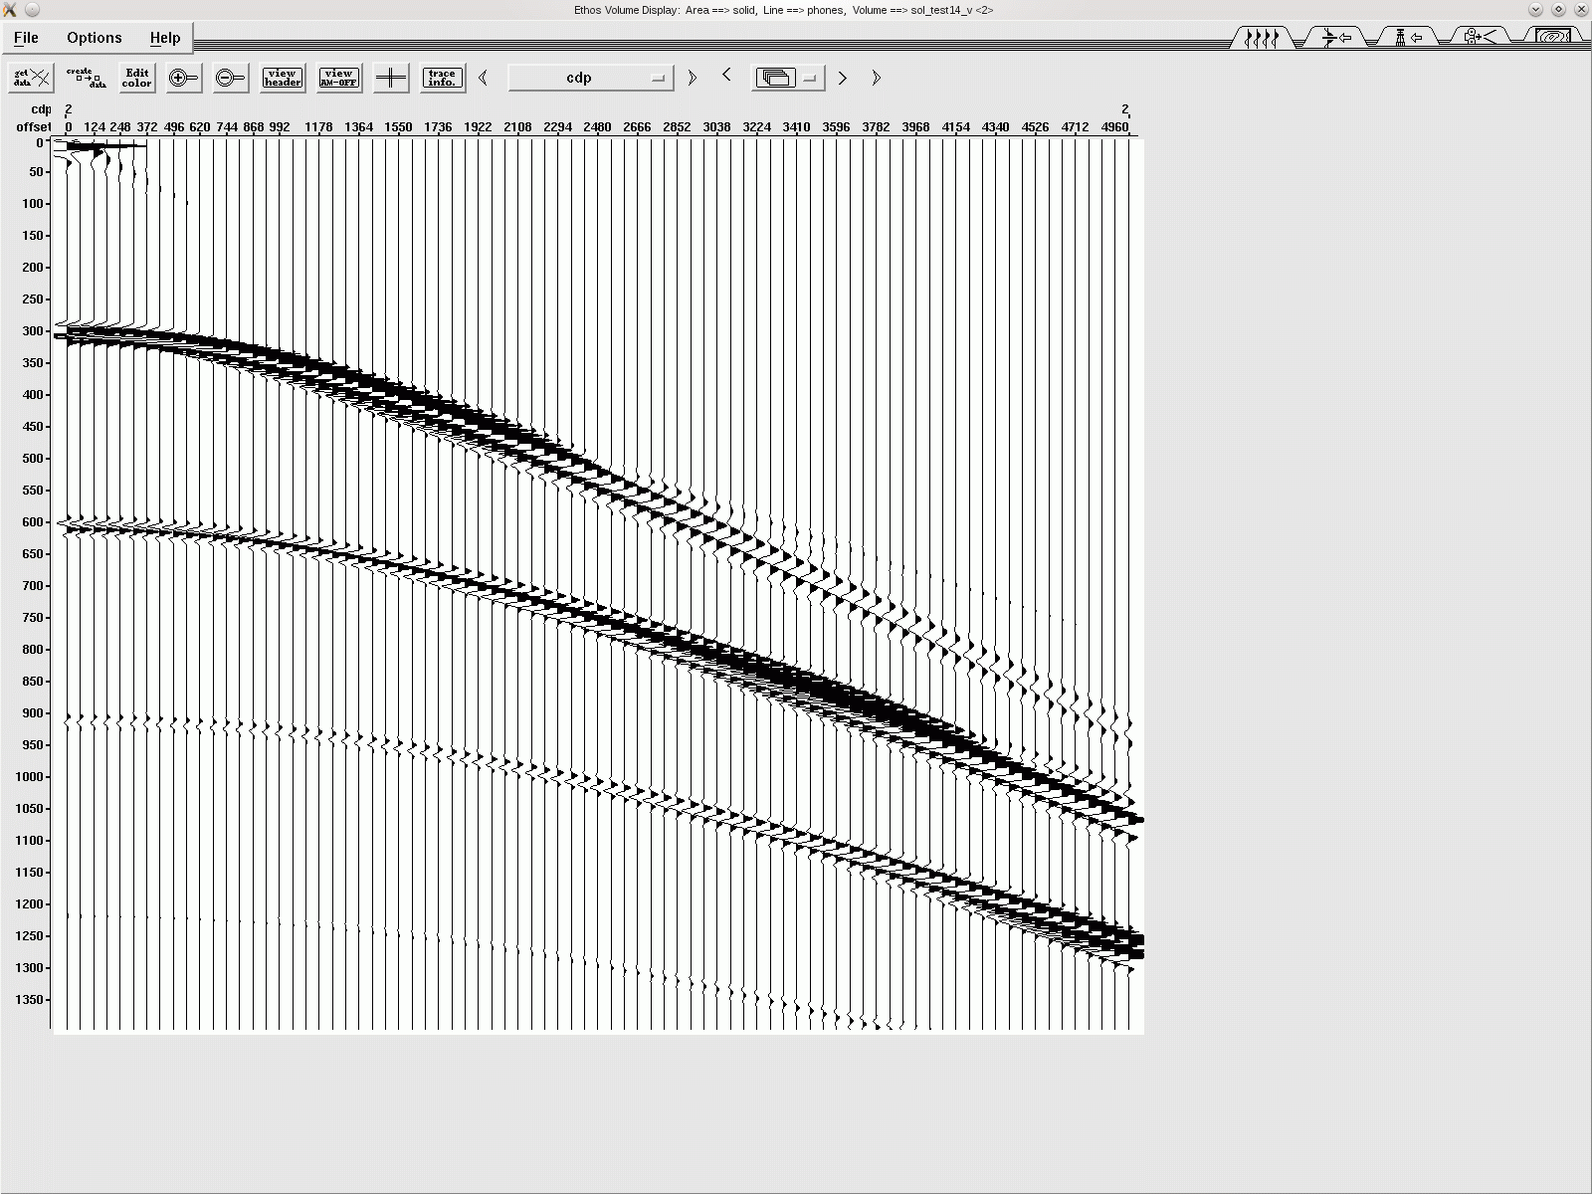
Acoustic Synthetic
Air
5600, 0, 2.00
850 ft
Acoustic
V_{SHEAR} = 0
ft/s ft/s g/cc
Refractor
Half
Space
9000, 0, 2.24
0 ft
Source-Receiver Offset
5000 ft
0 ft
5000 ft
|
|
|
|
|
|
|
|
|
|
|
|
_
0s
_
_
_
_
_
.5s
_
P2
_
_
_
P₁
_
1.0s
_
_
_
P_{Crit}
Notes:
1. With the shear wave velocity set to zero, it is relatively east to identify all the events.

Slide 7
Acoustic Synthetic
Air
5600, 0, 2.00
850 ft
Acoustic
V_{SHEAR} = 0
ft/s ft/s g/cc
Refractor
Half
Space
9000, 0, 2.24
0 ft
Source-Receiver Offset
5000 ft
0 ft
5000 ft
|
|
|
|
|
|
|
|
|
|
|
|
_
0s
_
(P₁P₁)
_
(P₁P₁)
_
_
(P₁P₁)(P₁P₂P₁)
_
(P₁P₂P₁)
2(P₁P₁)
.5s
2(P₁P₁)
_
P2
_
_
3(P₁P₁)
(P₁P₁)(P₁P₂P₁)
3(P₁P₁)
_
P₁
_
1.0s
_
4(P₁P₁)
2(P₁P₁)(P₁P₂P₁)
4(P₁P₁)
_
_
P_{Crit}
Notes:
The labeling of each event pertains the ray paths taken by the event.
The P1P1 event is obviously P1 down to the boundary and then p1 up to a receiver.
Right beneath the P1P1 is 2P1P1 which indicates a primary reflection and the 2 is for the multiple reflection.
Over on the right side there are head waves or refractions indicating paths P1 down to the boundary, P2 along the boundary and the P1 back up to the receiver. These are colored blue.
The red and blue events indicate that a multiple P1P1 occurred and then the refraction was generated.
There are three straight lines which indicate the Upper and lower velocities P1 and P2 and Pcrit which is the boundary between the reflections above sub- and post-critical.
Then we have the small reflections on the inside of Pcrit and the larger amplitude reflections on the outside of Pcrit.
Note the maximum amplitude is not necessarily at the critical angle but could be as shown where the reflection and head wave (refraction) constructively interfere.
A final note about this slide is that all P1P11 reflections are asymptotic to the P1 straight line. At the far offsets they will bunch up.
This was the easy one. Will add noon-zero shear-wave velocities and note the complexity generated.

Slide 8
Trapped and Leaky Acoustic Modes
Air
5600, 0, 2.00
850 ft
Acoustic
V_{SHEAR} = 0
ft/s ft/s g/cc
Refractor
Half
Space
9000, 0, 2.24
0 ft
Source-Receiver Offset
5000 ft
0 ft
5000 ft
|
|
|
|
|
|
|
|
|
|
|
|
_
0s
_
_
Trapped Modes
_
_
_
.5s
_
P2
_
_
_
P₁
_
1.0s
Leaky Modes
_
_
P_{Crit} = P₁²/P₂
_
P_{Crit}
P_{Crit}
Notes:
The labeling of each event pertains the ray paths taken by the event.
The P1P1 event is obviously P1 down to the boundary and then p1 up to a receiver.
Right beneath the P1P1 is 2P1P1 which indicates a primary reflection and the 2 is for the multiple reflection.
Over on the right side there are head waves or refractions indicating paths P1 down to the boundary, P2 along the boundary and the P1 back up to the receiver. These are colored blue.
The red and blue events indicate that a multiple P1P1 occurred and then the refraction was generated.
There are three straight lines which indicate the Upper and lower velocities P1 and P2 and Pcrit which is the boundary between the reflections above sub- and post-critical.
Then we have the small reflections on the inside of Pcrit and the larger amplitude reflections on the outside of Pcrit.
Note the maximum amplitude is not necessarily at the critical angle but could be as shown where the reflection and head wave (refraction) constructively interfere.
A final note about this slide is that all P1P11 reflections are asymptotic to the P1 straight line. At the far offsets they will bunch up.
This was the easy one. Will add noon-zero shear-wave velocities and note the complexity generated.

Slide 9
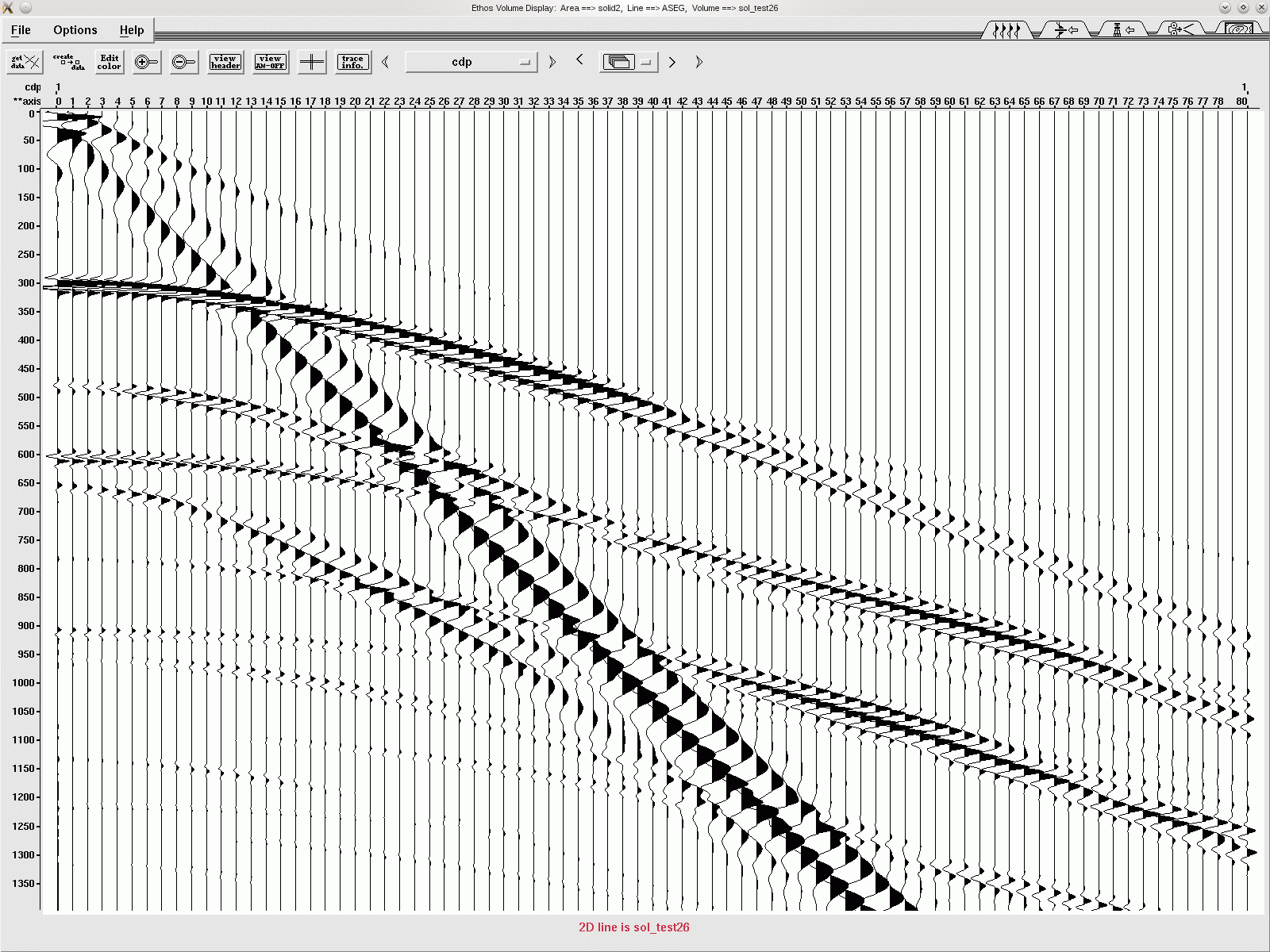
Equivalent Elastic Model
Air
5600, 2600, 2.00
850 ft
Elastic
ft/s ft/s g/cc
Refractor
Half
Space
9000, 3960, 2.24
0 ft
Source-Receiver Offset
5000 ft
|
|
|
|
|
|
_
0s
_
_
_
_
_
.5s
_
_
_
_
_
1.0s
_
_
_
Notes:
1. There are numerous events that are not clearly evident because of the low amplitude, so an AGC will help in the identification of all possible events.

Slide 10
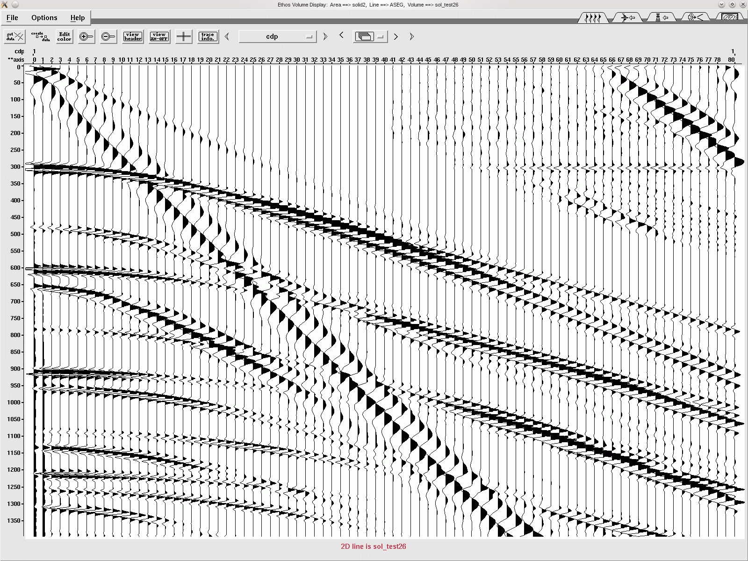
Event Identification – Elastic Model
Air
5600, 2600, 2.00
850 ft
Near Surface
Direct, Rayleigh, ???
ft/s ft/s g/cc
Refractor
Half
Space
9000, 3960, 2.24
0 ft
Source-Receiver Offset
5000 ft
|
|
|
|
|
|
_
0s
AGC
_
_
_
P₁ – Direct Arrival
_
_
.5s
_
Rayleigh Wave
_
_
_
S₁
_
1.0s
_
_
_
Notes:
Yep. The synthetic got complex quickly just by introducing non-zero shear velocities.
The first three events are the P1 and S1 direct arrivals.
Did I say S1 event? Yes, since the source is buried below the air boundary, P energy will reflect off the air interface and a significant portion will convert into a shear wave emanating from the surface.
The Rayleigh wave is rather easy to pick, it has a linear moveout velocity of 0.92 shear velocity and is no dispersive. We expect this since the source has wavelengths from 20-140 ft that have amplitudes that are 20% of the maximum amplitude. The layer thickness of 850 ft is well beyond the 140 ft wavelength that travels below the surface.

Slide 11
Event Identification – Elastic Model
Air
5600, 2600, 2.00
850 ft
Reflections: P₁P₁
Head Waves: P₁P₂P₁
ft/s ft/s g/cc
Refractor
Half
Space
9000, 3960, 2.24
0 ft
Source-Receiver Offset
5000 ft
|
|
|
|
|
|
_
0s
AGC
_
_
(P₁P₁)
_
_
_
.5s
2(P₁P₁)
(P₁P₂P₁)
_
_
_
3(P₁P₁)
(P₁P₁)(P₁P₂P₁)
_
Asymptote P₁
_
1.0s
_
4(P₁P₁)
2(P₁P₁)(P₁P₂P₁)
_
_
Notes:
As the title indicates, these events are related to the P1P1 reflection or its associated head wave P1P2P1.
Once again, the naming of the events is color coded. One notices a significant amount of P1P1 events, both for the reflections and refractions.

Slide 12
Event Identification – Elastic Model
Air
5600, 2600, 2.00
850 ft
Reflections: P₁S₁
Head Waves: P₁P₂S₁
ft/s ft/s g/cc
Refractor
Half
Space
9000, 3960, 2.24
0 ft
Source-Receiver Offset
5000 ft
|
|
|
|
|
|
_
0s
AGC
_
_
_
_
(P₁S₁)
_
.5s
_
(P₁P₂S₁)
_
(P₁P₁)(P₁S₁)
_
_
_
2(P₁P₁)(P₁S₁)
(P₁P₁)(P₁P₂S₁)
1.0s
_
_
_
3(P₁P₁)(P₁S₁)
2(P₁P₁)(P₁P₂S₁)
Notes:
As the title indicates, P1S1 reflection events and associated refractions are identified.
Where the refraction and PS reflection are tangent, the constructive amplitude is significant.
So far, we identified the reflections that were PP and PS events.
The next set comes as a bit of surprise as it is SS reflections.

Slide 13
Event Identification – Elastic Model
Air
5600, 2600, 2.00
850 ft
Reflections: S₁S₁
Head Waves: S₁P₂S₁
ft/s ft/s g/cc
Refractor
Half
Space
9000, 3960, 2.24
0 ft
Source-Receiver Offset
5000 ft
|
|
|
|
|
|
_
0s
AGC
_
_
_
_
_
.5s
_
(S₁S₁)
_
_
_
(P₁P₁)(S₁S₁)
(S₁P₂S₁)
_
1.0s
(S₁S₂S₁)
_
(P₁S₁)(S₁S₁)
_
2(P₁P₁)(S₁S₁)
_
2(S₁S₁)
Asymptote S₁
Notes:
As mentioned the P-wave source generates a s-wave at the air interface and it can propagates as if it was a shear source near the air interface.
These are a bit more confusing because of the variety of waves that the s-wave generates within the Rayleigh wave.
There is the S1S1 as expected along with the P1P1 then S1S1 and of course the multiple S1S1 event.
Another event that is not expected is the P1S1 and then S1S1.
The are two refraction for the s-wave. One propagating along the refractor interface at P2 and the other at S2 velocity.
As you realize, there are many events that are generated from what appears to be a simple one reflector model.
If we put the identified events all together in the next slide … you will see that “all” the major amplitude events have been cataloged.

Slide 14
Event Identification – Elastic Model
Air
5600, 2600, 2.00
850 ft
24 Event Summary
Four Groups
ft/s ft/s g/cc
Refractor
Half
Space
9000, 3960, 2.24
0 ft
Source-Receiver Offset
5000 ft
|
|
|
|
|
|
_
(S₁S₁)
0s
AGC
_
_
(P₁P₁)
_
(S₁P₂S₁)
_
_
(P₁P₂P₁)
.5s
(S₁S₂S₁)
_
_
_
_
(P₁S₁)
_
P1
S1
1.0s
_
(P₁P₂S₁)
_
Rayleigh
_
Notes:
There are four groups of events that occur.
Those associated with P1P1, colored red. Those associated with converted energy P1S1. Because of the air interface, there are S1S1 events, colored purple.
Finally, we have the direct arrivals (without reflection) which are P1, S1 and the Rayleigh wave.
What we didn’t see were any indications of guided waves. To see those we needed to introduce some sort of interference pattern to get events with a phase velocity different from the group velocity

Slide 15
Outline
Near-Surface Events …
Elastic synthetics
  Identify events
  Define asymptotes of events
  Vary near-surface thickness
  Vary refractor thickness
Notes:
1. Here are examples from the last 30 years where the reflectivity code allowed us to shout “Eureka” … look “I found it”.
2. The first part of my talk covers near-surface events and leads to an understanding of the various “noise” cones we see on shot records.
3. Secondly, a new processing algorithm was developed, that is imaging shallow portions of salt domes by 3D migration of refraction arrivals. This was undertaken once the failure of the reflection process was recognized by reflectivity modeling.
4. The last example relates to the identification of signal from noise in Cooper Basin coal beds and leads to a method of separating S and N.

Slide 16
Limits and Asymptotes
Air
5600, 2600, 2.00
850 ft
Guided Waves
Ground Roll
ft/s ft/s g/cc
Refractor
Half
Space
9000, 3960, 2.24
0 ft
Source-Receiver Offset
5000 ft
|
|
|
|
|
|
_
0s
AGC
_
R₁ ≈ .92 S₁
R₂ ≈ .92 S₂
P_{CRIT} = P₁²/P₂
S_{CRIT} = S₁²/S₂
_
_
_
_
Guided Waves
(Trapped Modes)
.5s
_
P₂
_
_
P₁ asymptote
for all n(P₁P₁)
S₁ asymptote
for all n(S₁S₁)
_
P₁
_
1.0s
_
_
Rayleigh Waves
(Ground Roll)
_
S₂
R₂
S_{CRIT}
R₁
S₁
P_{Crit}
Notes:
1. An interesting feature about the P1S1 reflection in the yellow bed is that at large offsets, P1 begins to parallel the interface boundary so that the emergence angle of S1 becomes constant and the PS event has the characteristics of a refraction as far as the intercept and slope of its asymptote is concerned.
This is shown in the slide and it is indicated that the intercept time is similar to a refraction intercept time.
Alright, all the necessary events and asymptotes have been identified, now the fun begins as the yellow layer is thinned. Remember, the refractor is a half space.

Slide 17
Outline
Near-Surface Events …
Elastic synthetics
  Identify events
  Define asymptotes of events
  Vary near-surface thickness
  Vary refractor thickness
Notes:
1. Here are examples from the last 30 years where the reflectivity code allowed us to shout “Eureka” … look “I found it”.
2. The first part of my talk covers near-surface events and leads to an understanding of the various “noise” cones we see on shot records.
3. Secondly, a new processing algorithm was developed, that is imaging shallow portions of salt domes by 3D migration of refraction arrivals. This was undertaken once the failure of the reflection process was recognized by reflectivity modeling.
4. The last example relates to the identification of signal from noise in Cooper Basin coal beds and leads to a method of separating S and N.

Slide 18
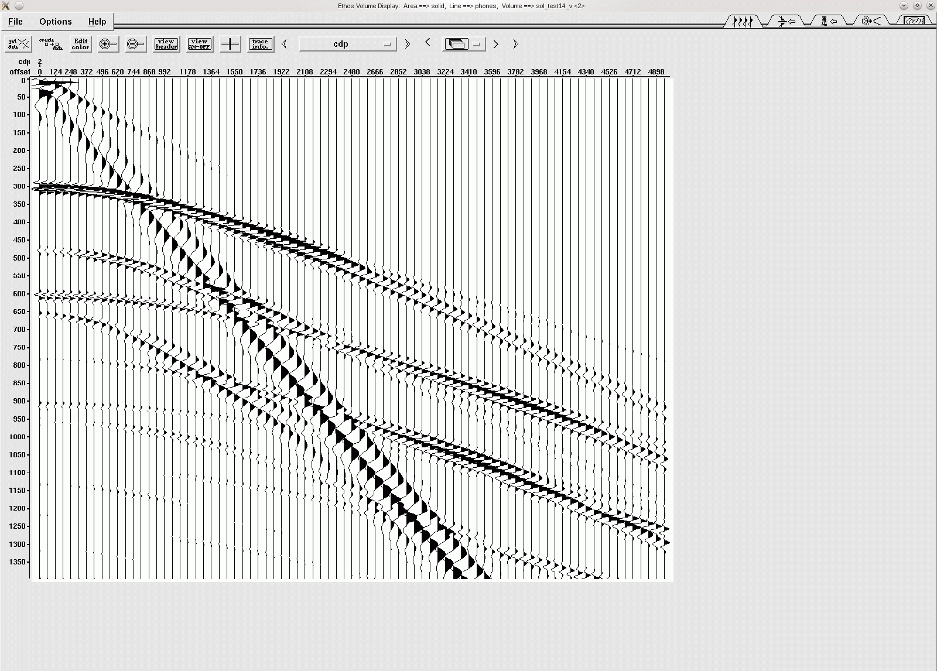
Near Surface Thickness
Air
5600, 2600, 2.00
850 ft
Thickness = 850 ft
ft/s ft/s g/cc
Refractor
Half
Space
9000, 3960, 2.24
0 ft
Source-Receiver Offset
5000 ft
|
|
|
|
|
|
_
0s
_
_
_
_
_
.5s
_
P₂
_
_
_
P₁
_
1.0s
_
_
_
R₂
S_{CRIT}
R₁
P_{Crit}
S₁
Notes:
This is own standard 850ft thick layer model again.
There are a couple of events that are worthy of noting. The first is the S1S1 reflection that is asymptotic to the Rayleigh (or actually the S1 line).
All the PP reflections stay below the orange P1 line while above are the refraction events.
Watch the PP reflection and multiple events at the near traces. They occur at .3 and .6s.

Slide 19
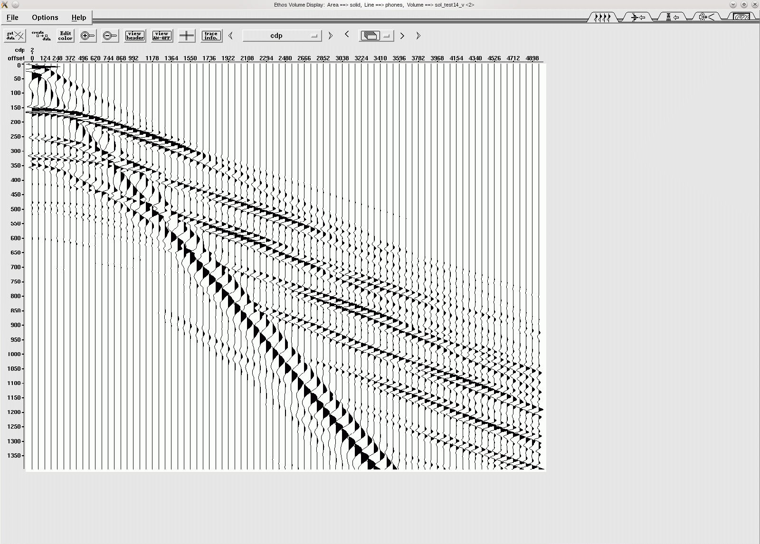
Near Surface Thickness
Air
5600, 2600, 2.00
450 ft
Thickness = 450 ft
ft/s ft/s g/cc
Refractor
Half
Space
9000, 3960, 2.24
0 ft
Source-Receiver Offset
5000 ft
|
|
|
|
|
|
_
0s
_
_
_
_
_
.5s
_
P₂
_
_
_
P₁
_
Guided waves collect
in P_{Crit}-P₁ cone
1.0s
_
_
Post-critical S-waves
collect in S_{Crit}-S₁ Cone
_
R₂
S_{CRIT}
R₁
P_{Crit}
S₁
Notes:
We can still identify the reflections that stay beneath the P1 slope as the bed is thinned to 450ft. We will see the reflections slowly merge into refractions in the next couple of slides.
Did you notice the S1S1 reflections. The S1S1 and the 2S1S1 are asymptotic to R1 and also the energy starts at the Scrit line. That is, the trapped S1S1 waves have amplitude while the leaky S1S1 waves have little amplitude.
In short, between Pcrit and P1 are the trapped modes for P1P1, this is the cone associated with guided waves. Similarly, between Scrit and S1 are the trapped S1S1 mode or a second cone of guided waves. Compare the developing energy in the Scrit-S1 cone to the Pcrit-P1 cone as the bed thickness is decreased progressively from 450ft to 150ft.
We shouldn’t see much change in the Rayleigh wave as 150ft is still deeper than the longest significant wavelength of the source which is about 140 ft.

Slide 20
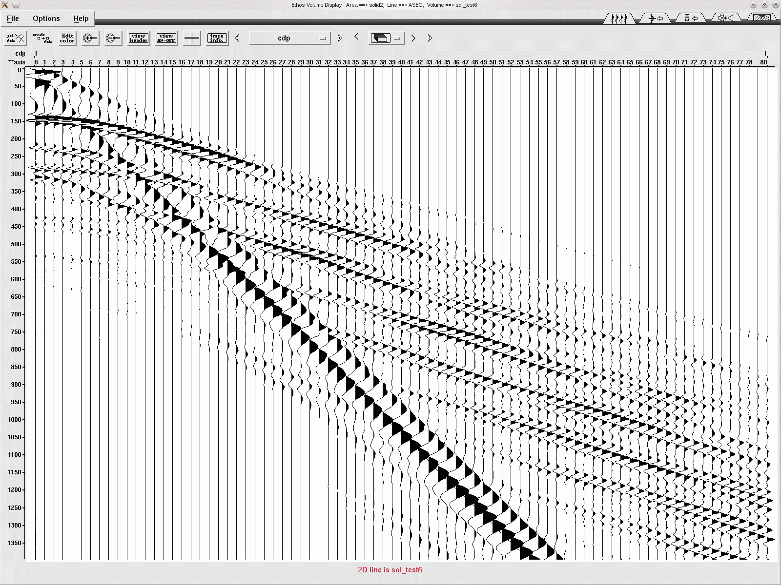
Near Surface Thickness
Air
5600, 2600, 2.00
400 ft
Thickness = 400 ft
ft/s ft/s g/cc
Refractor
Half
Space
9000, 3960, 2.24
0 ft
Source-Receiver Offset
5000 ft
|
|
|
|
|
|
_
0s
_
_
_
_
_
.5s
P₂
_
_
_
_
P₁
_
1.0s
_
_
_
R₂
S_{CRIT}
R₁
P_{Crit}

Slide 21

Near Surface Thickness
Air
5600, 2600, 2.00
350 ft
Thickness = 350 ft
ft/s ft/s g/cc
Refractor
Half
Space
9000, 3960, 2.24
0 ft
Source-Receiver Offset
5000 ft
|
|
|
|
|
|
_
0s
_
_
_
_
_
.5s
_
P₂
_
_
_
P₁
_
1.0s
_
_
_
R₂
S_{CRIT}
R₁
P_{Crit}

Slide 22
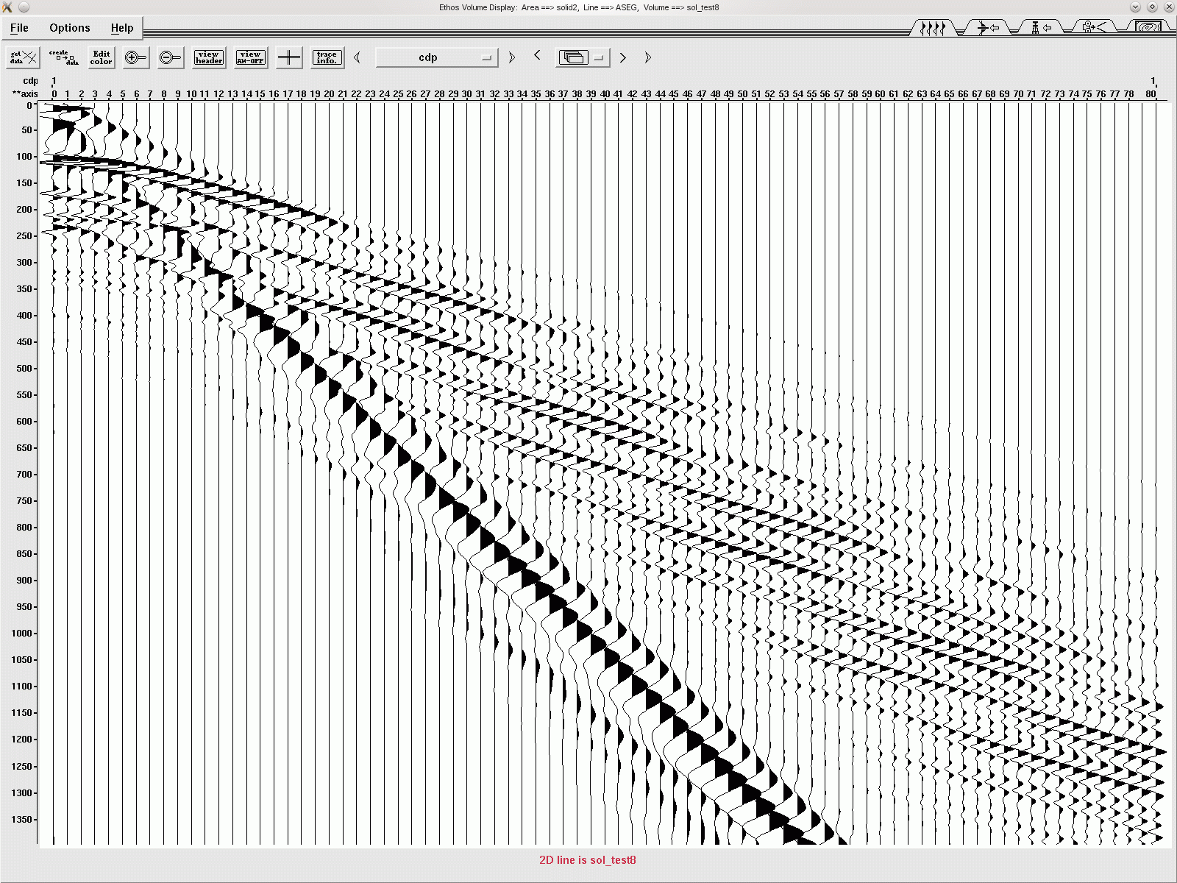
Near Surface Thickness
Air
5600, 2600, 2.00
300 ft
Thickness = 300 ft
ft/s ft/s g/cc
Refractor
Half
Space
9000, 3960, 2.24
0 ft
Source-Receiver Offset
5000 ft
|
|
|
|
|
|
_
0s
_
_
_
_
_
.5s
_
P₂
_
_
_
P₁
_
1.0s
_
_
_
R₂
S_{CRIT}
R₁
P_{Crit}

Slide 23
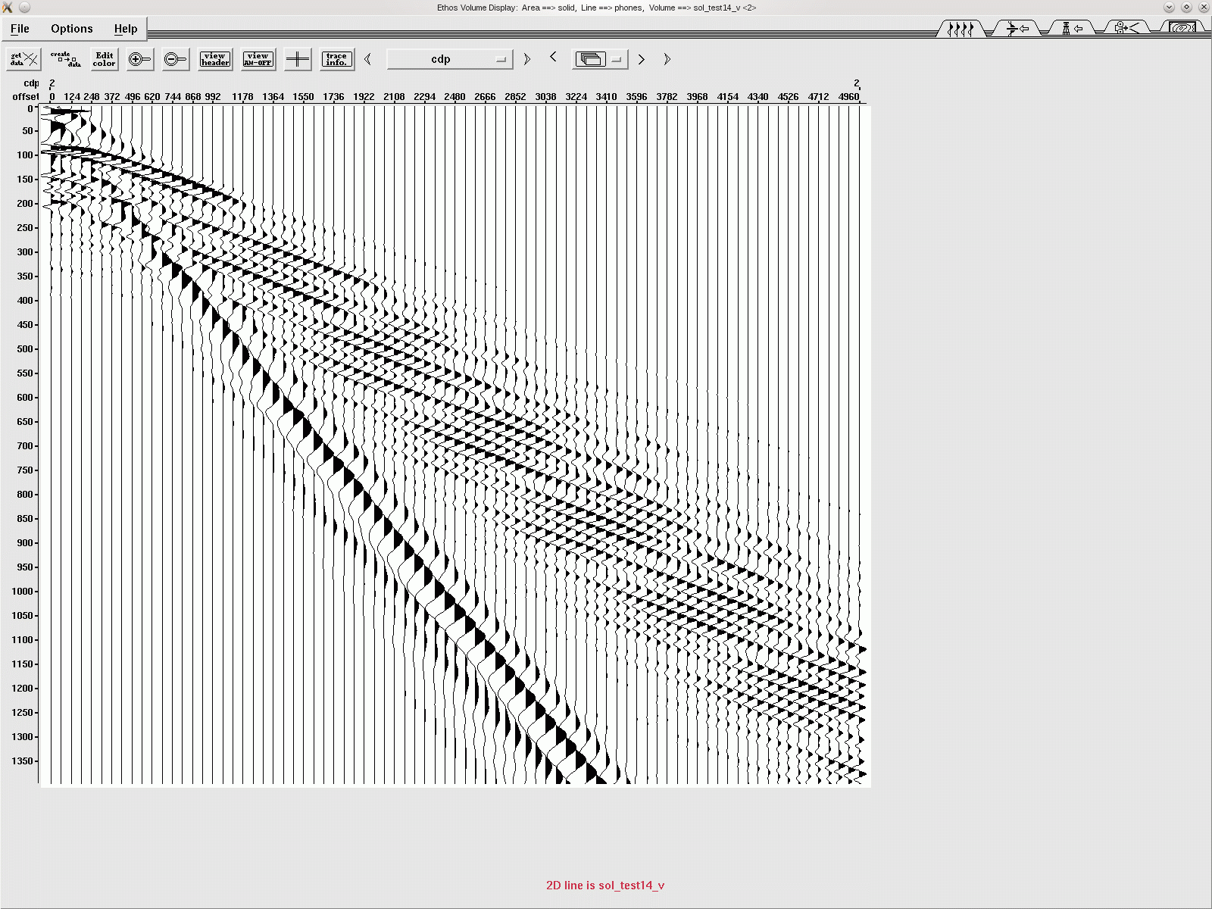
Near Surface Thickness
Air
5600, 2600, 2.00
250 ft
Thickness = 250 ft
ft/s ft/s g/cc
Refractor
Half
Space
9000, 3960, 2.24
0 ft
Source-Receiver Offset
5000 ft
|
|
|
|
|
|
_
0s
_
_
_
_
_
.5s
_
P₂
_
_
_
P₁
_
1.0s
_
_
_
R₂
S_{CRIT}
R₁
P_{Crit}
Notes:
Now it’s becoming more difficult to identify the individual reflection multiples at 250 ft thickness.

Slide 24
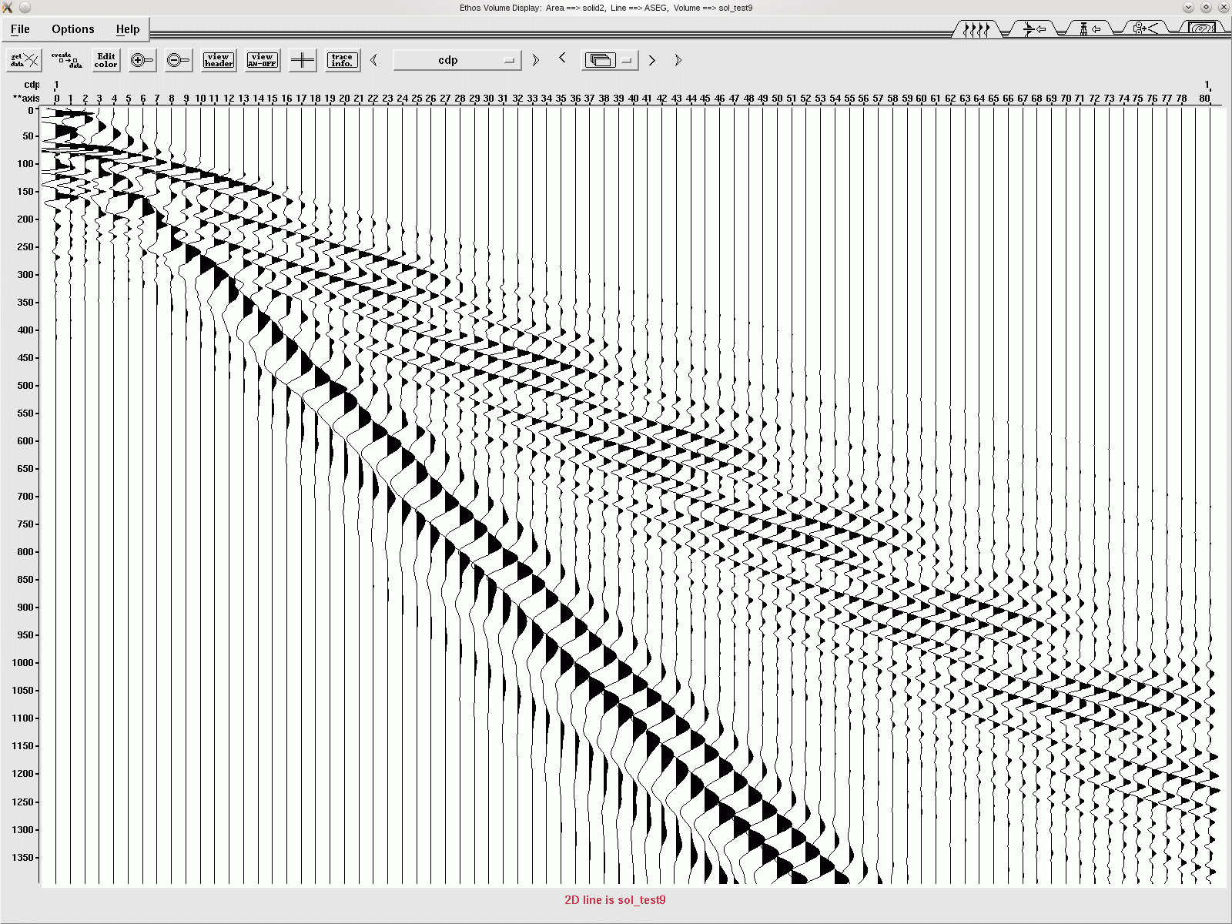
Near Surface Thickness
Air
5600, 2600, 2.00
200 ft
Thickness = 200 ft
ft/s ft/s g/cc
Refractor
Half
Space
9000, 3960, 2.24
0 ft
Source-Receiver Offset
5000 ft
|
|
|
|
|
|
_
0s
_
_
_
_
_
.5s
_
P₂
_
_
_
P₁
_
Guided waves show
phase velocity
1.0s
_
_
Shear guided waves
appear as ground roll
_
R₂
S_{CRIT}
R₁
P_{Crit}
S₁

Slide 25
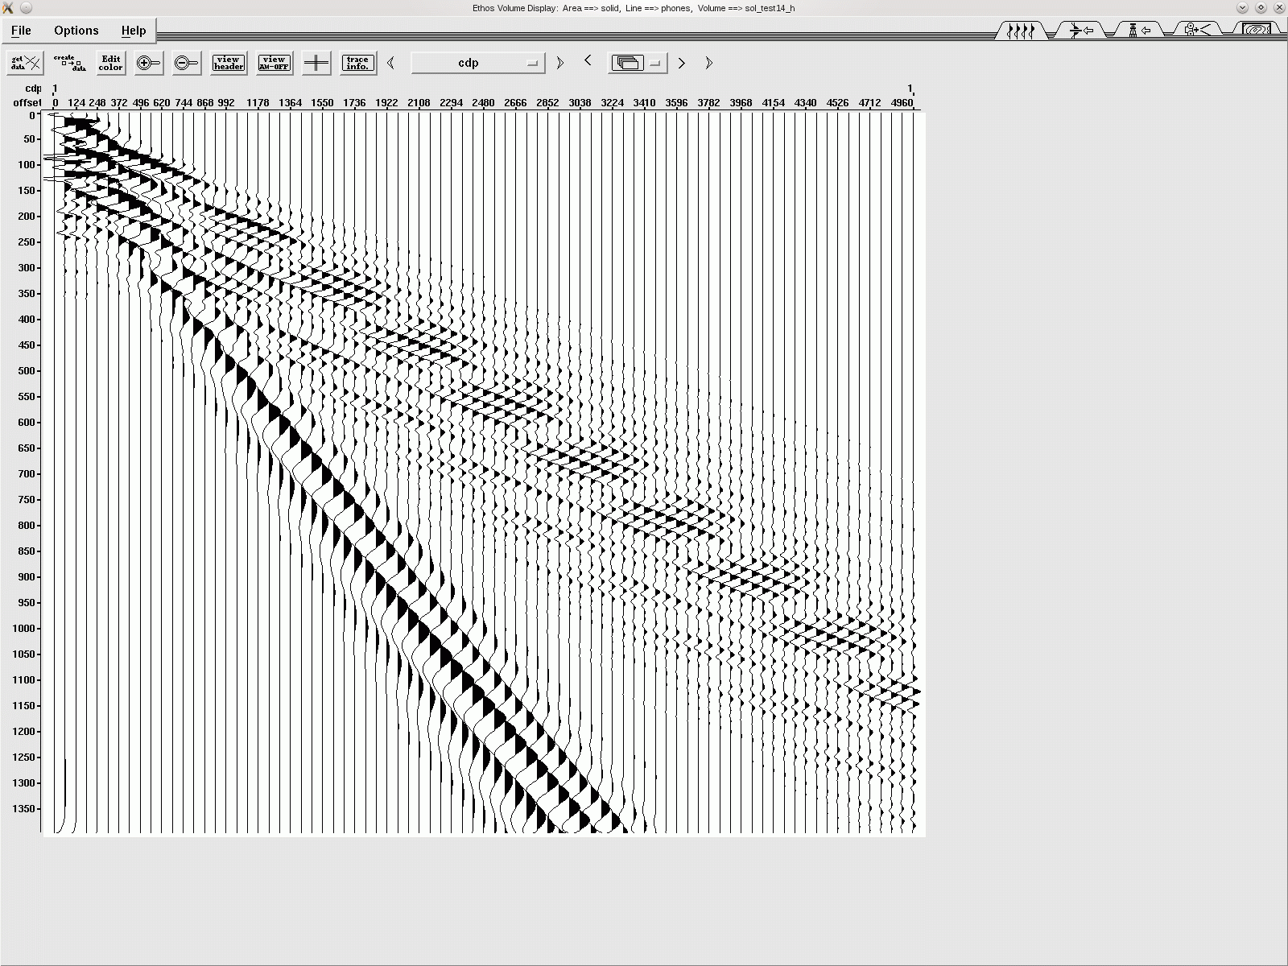
Near Surface Thickness
Air
5600, 2600, 2.00
150 ft
Thickness = 150 ft
ft/s ft/s g/cc
Refractor
Half
Space
9000, 3960, 2.24
0 ft
Source-Receiver Offset
5000 ft
|
|
|
|
|
|
_
0s
_
_
_
_
_
.5s
_
P₂
_
_
_
P₁
_
1.0s
_
_
_
R₂
S_{CRIT}
R₁
P_{Crit}
Notes:
At 150 ft, the reflections are still below the 5600 ft/s slope and refraction events are becoming more evident above the 5600 ft/s slope.

Slide 26
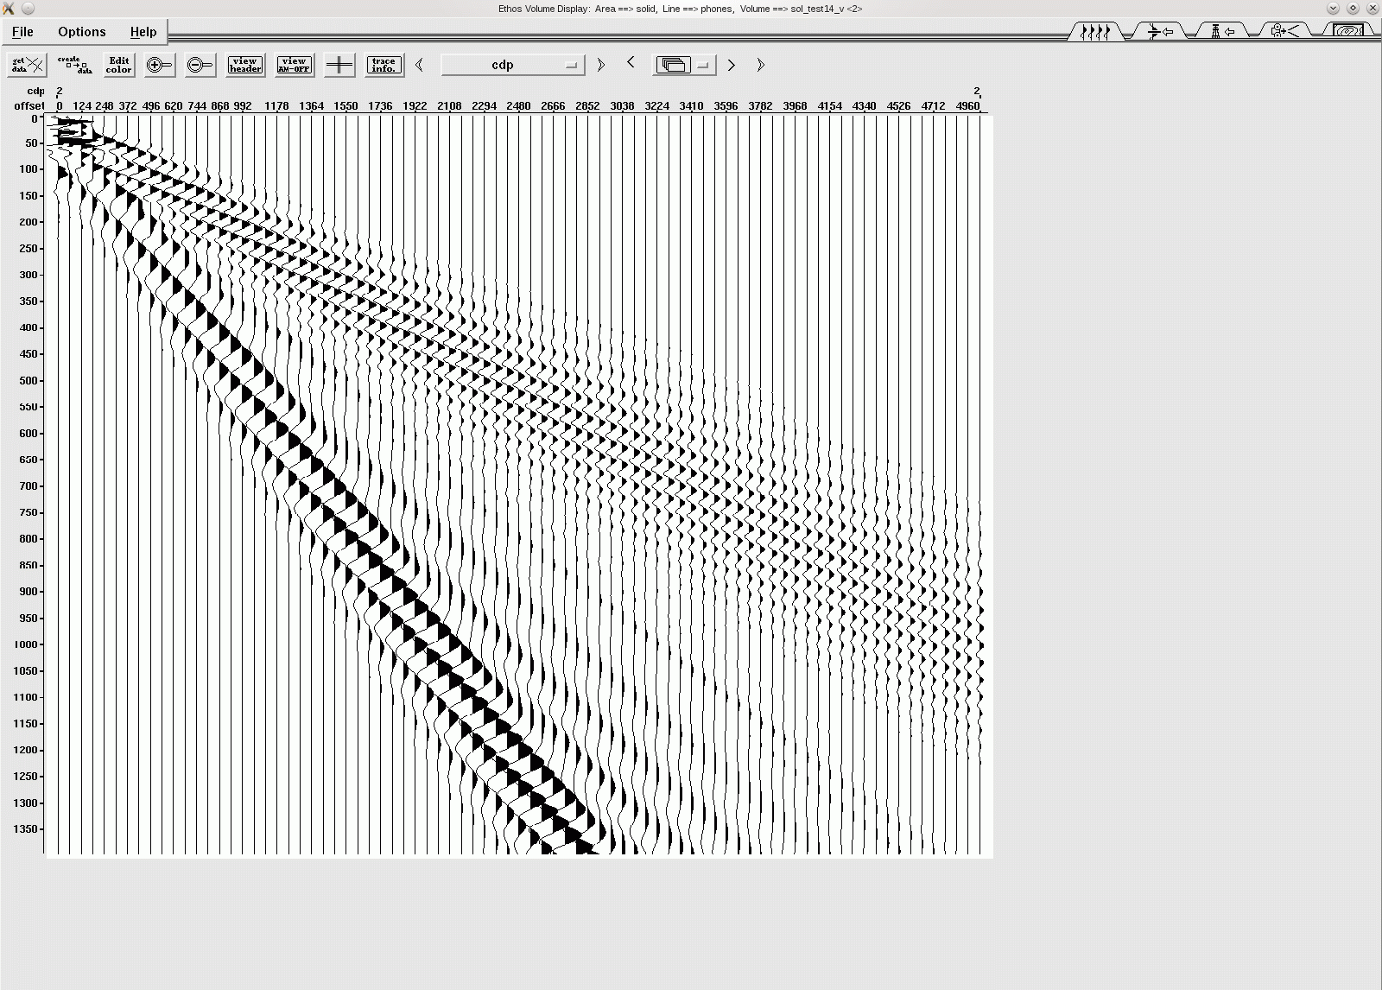
Near Surface Thickness
Air
5600, 2600, 2.00
90 ft
Thickness = 90 ft
ft/s ft/s g/cc
Refractor
Half
Space
9000, 3960, 2.24
0 ft
Source-Receiver Offset
5000 ft
|
|
|
|
|
|
_
0s
_
_
_
_
_
.5s
_
P₂
_
_
_
P₁
_
Refractions overcome
guided waves in
P_{Crit}-P₁ cone as
P₁ layer thins
1.0s
_
_
Long λ appear in
Rayleigh cone R₁-R₂
_
R₂
S_{CRIT}
R₁
P_{Crit}
S₁
Notes:
At 90 ft thickness, the multiple P1P1 and P1S1 reflection events have appeared to merge with the refractions leaving only multiple refraction events.
In fact the trapped reflections that started at Pcrit are now losing amplitude … leaving a non-reflection area.
Changes in the Rayleigh wave cone begin to appear also between R1 and R2.

Slide 27
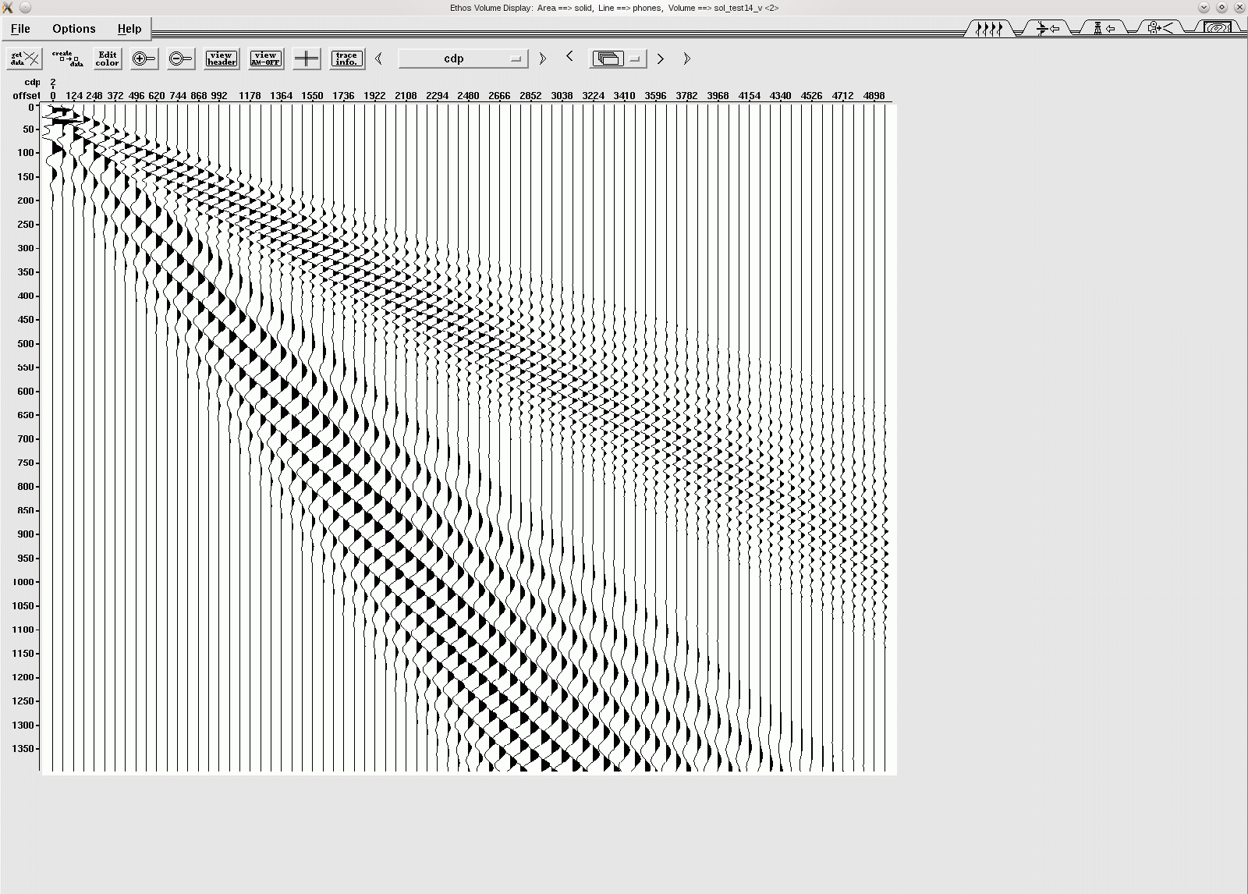
Near Surface Thickness
Air
5600, 2600, 2.00
60 ft
Thickness = 60 ft
ft/s ft/s g/cc
Refractor
Half
Space
9000, 3960, 2.24
0 ft
Source-Receiver Offset
5000 ft
|
|
|
|
|
|
_
0s
_
P₁ and P_{crit} effects decrease as upper layer thickness decreases
_
_
_
_
.5s
_
P₂
_
_
_
P₁
_
As P₁ layer thins
refractions move to P₂
1.0s
_
_
Post S₁S₁ and Rayleigh
merge in S_{Crit}-R₂ cone
_
R₂
S_{CRIT}
R₁
P_{Crit}
S₁
Notes:
As the upper layer thins to 60ft, the multiple refractions approach the 9000 ft/s refraction slope of the high-velocity bed.
The guided waves have moved into the refraction cone and the phase velocity slowly changed to is that of the P2 the refractor.
The Rayleigh waves look continuous in the cone Scrit-R2 not just R1-R2 because the initial shear source has helped fill the innermost cone.

Slide 28
Outline
Near-Surface Events …
Elastic synthetics
  Identify events
  Define asymptotes of events
  Vary near-surface thickness
  Vary refractor thickness
Notes:
1. Here are examples from the last 30 years where the reflectivity code allowed us to shout “Eureka” … look “I found it”.
2. The first part of my talk covers near-surface events and leads to an understanding of the various “noise” cones we see on shot records.
3. Secondly, a new processing algorithm was developed, that is imaging shallow portions of salt domes by 3D migration of refraction arrivals. This was undertaken once the failure of the reflection process was recognized by reflectivity modeling.
4. The last example relates to the identification of signal from noise in Cooper Basin coal beds and leads to a method of separating S and N.

Slide 29
Refractor Thickness Variation
Air
5600, 2600, 2.00
60 ft
ft/s ft/s g/cc
Refractor Thickness = Infinite
Refractor
Half
Space
9000, 3960, 2.24
0 ft
Source-Receiver Offset
5000 ft
|
|
|
|
|
|
_
0s
_
_
_
_
_
.5s
_
P₂
_
_
_
P₁
_
1.0s
_
_
_
R₂
S_{CRIT}
R₁
P_{Crit}
S₁
Notes:
1. We’ll repeat that Guide wave synthetic and the refractor thickness will be reduced from infinite thickness to a 200ft refractor.

Slide 30
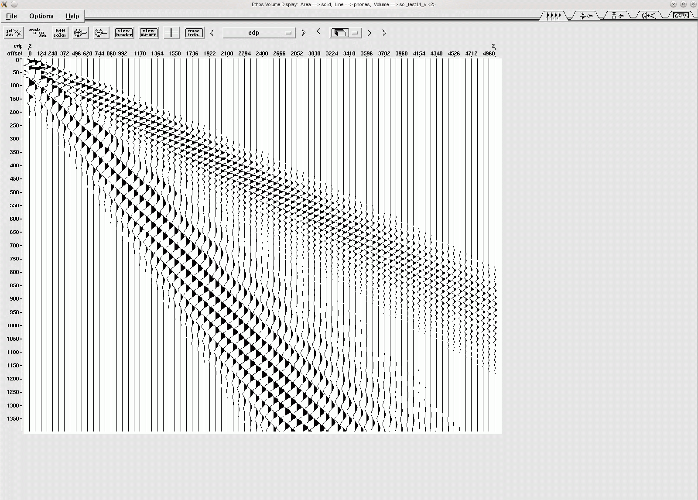
Refractor Thickness Variation
Air
5600, 2600, 2.00
60 ft
ft/s ft/s g/cc
Refractor Thickness = 200 ft
Refractor
200 ft
9000, 3960, 2.24
5400, 2380, 2.21
Half
Space
Refractor thickness decreases, head wave
loses amplitude
horizontal velocity is constant
0 ft
Source-Receiver Offset
5000 ft
|
|
|
|
|
|
_
0s
_
_
_
_
_
.5s
_
P₂
_
_
_
P₁
_
1.0s
_
_
_
R₂
S_{CRIT}
R₁
P_{Crit}
Notes:
If I flip back and forth, you notice that the only difference is that the refraction energy is moving away from 9000ft/s slope. Basically, a refractor cannot carry energy very far when it is too thin. However, the amplitude of the multiple reflections around the critical angle only lose energy by 1/distance traveled and that isn’t too far. The horizontal velocity of the events remains the same. Let’s decrease the refractor thickness even more to 100 ft and watch the multiple refraction energy.

Slide 31
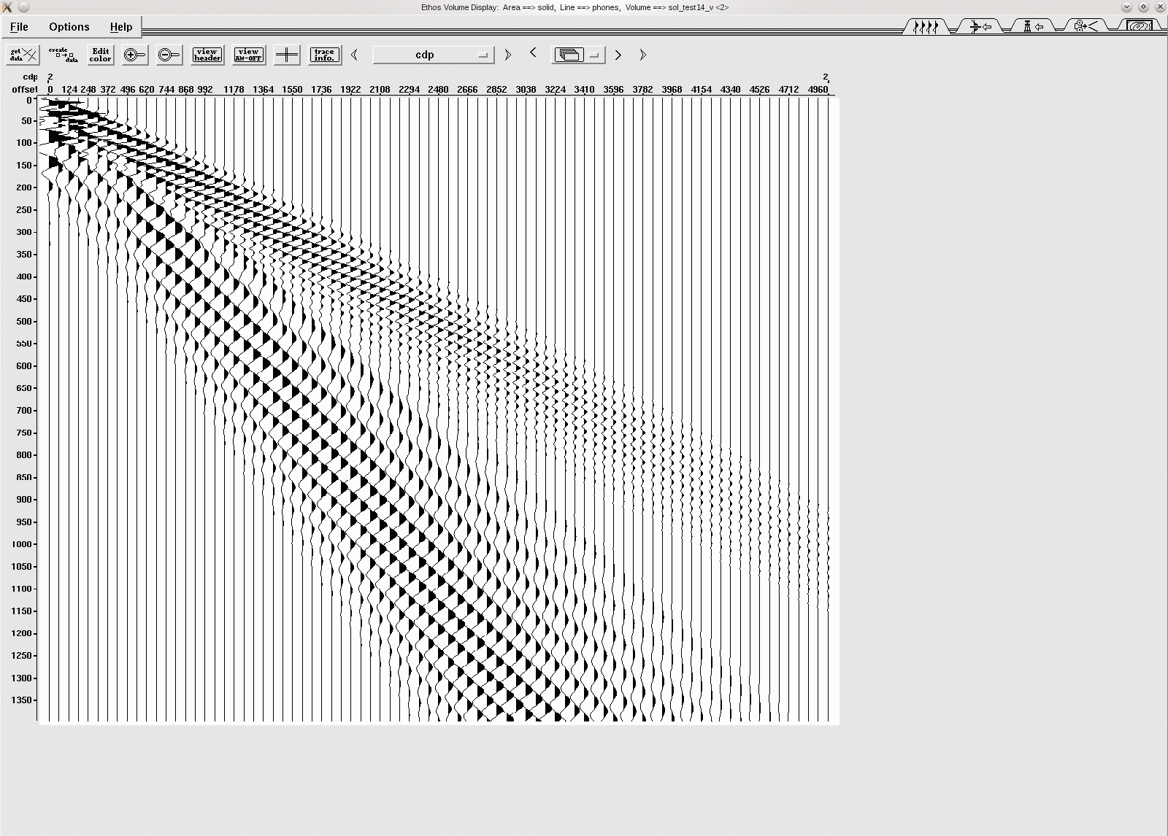
Refractor Thickness Variation
Air
5600, 2600, 2.00
60 ft
ft/s ft/s g/cc
Refractor Thickness = 100 ft
Refractor
100 ft
9000, 3960, 2.24
5400, 2380, 2.21
Half
Space
0 ft
Source-Receiver Offset
5000 ft
|
|
|
|
|
|
_
0s
_
_
_
_
_
.5s
_
P₂
_
_
_
P₁
_
1.0s
_
_
_
R₂
S_{CRIT}
R₁
P_{Crit}
Notes:
The energy traveling in the refractor decays even faster. Each successful multiple reflection bounce excites head waves into the refractor.

Slide 32
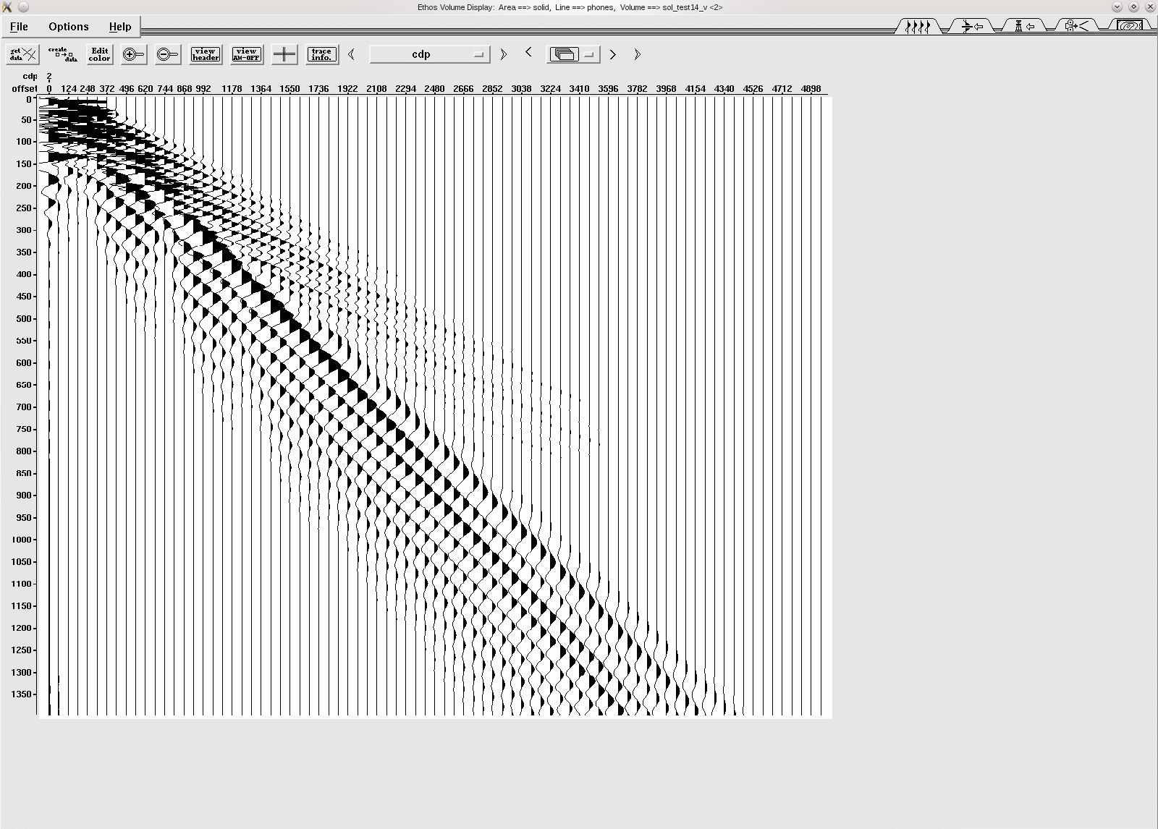
Refractor Thickness Variation
Air
5600, 2600, 2.00
60 ft
ft/s ft/s g/cc
Refractor Thickness = 50 ft
Refractor
50 ft
9000, 3960, 2.24
5400, 2380, 2.21
Half
Space
0 ft
Source-Receiver Offset
5000 ft
|
|
|
|
|
|
_
0s
_
_
_
_
_
.5s
_
P₂
_
_
_
P₁
_
P₂ layer thins,
refractions lose
amplitude with offset
1.0s
_
_
Post-critical S₁S₁ effects decrease
_
R₂
S_{CRIT}
R₁
P_{Crit}
S₁
Notes:
Finally, at a refractor bed thickness of 50 ft we get the classical shingling effect.
The Rayleigh wave begins to lose amplitude between Scrit-S1 because the new lower half space has a S-wave velocity less than the shallow layer and thus the Scrit begins to disappear as the refractor becomes thinner.

Slide 33
Refractor Thickness Variation
Air
60 ft
Shingling
Thin Layer over Thin Refractor
Upper Layer
Refractor
50 ft
Lower Layer
Half
Space
0 ft
Source-Receiver Offset
5000 ft
|
|
|
|
|
|
_
0s
_
_
_
_
_
.5s
_
P₂
_
_
_
P₁
_
1.0s
_
_
_
R₂
S_{CRIT}
R₁
P_{Crit}
Oz Yilmaz
S₁
Notes:
In summary, while a thin upper layer supports the transformation of guided waves to multiple refraction events, also by thinning the refractor thickness, shingling events appear.
So thin refraction layers reduce the head-wave amplitude, what else does.

Slide 34
Refractor Thickness Variation
Air
60 ft
Shingling
Thin Layer over Thin Refractor
Upper Layer
Refractor
50 ft
Lower Layer
Half
Space
0 ft
Source-Receiver Offset
5000 ft
|
|
|
|
|
|
_
0s
_
_
_
_
_
.5s
_
P₂
_
_
Shingling
n^{th} Critical-angle reflection (amplitude =1) generates head wave
n^{th} Head wave loses amplitude due to thin refractor layer
n^{th} +1 Critical-angle reflection (amplitude =1) generates head wave
n^{th} + 1 Head wave loses amplitude due to thin refractor layer
Repeat
_
P₁
_
1.0s
_
_
_
R₂
S_{CRIT}
R₁
P_{Crit}
Oz Yilmaz
S₁
Notes:
In summary, while a thin upper layer supports the transformation of guided waves to multiple refraction events, also by thinning the refractor thickness, shingling events appear.
So thin refraction layers reduce the head-wave amplitude, what else does.

Slide 35
Summary: Reflectivity Modeling of Near-Surface Events
Velocity asymptotes “quantify” event cones
        Guided S-waves
        Rayleigh waves
        Guided P-waves
        Refraction arrivals
Shingling and multiple refractions “quantified” by
    P-wave and S-wave velocities
    Thickness of upper layer and refractor
Lessons from near-surface modeling
Start with simplest model and learn with each model variation.

Slide 36
That’s it!
Thanks for your attention

